Slide 1
The Network Layer and IP Protocol

Slide 2
Datagram subnets route each packet as a separate unit, independent of all others. Virtual-circuit subnets do not have to do this, since each data packet follows a predetermined route. Does this observation mean that virtual-circuit subnets do not need the capability to route isolated packets from an arbitrary source to an arbitrary destination? Explain your answer.

Slide 3
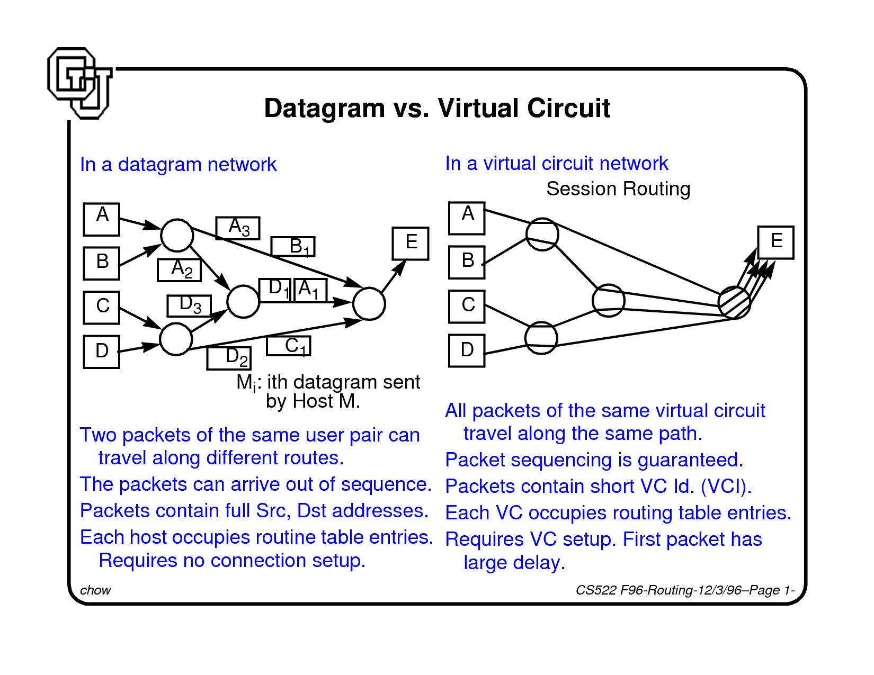
Virtual circuit networks most certainly need this capability in order to route connection setup packets from an arbitrary source to an arbitrary destination.
Virtual circuit networks most certainly need this capability in order to route connection setup packets from an arbitrary source to an arbitrary destination.

Slide 4
Assuming that all routers and hosts are working properly and that all software in both is free of all errors, is there any chance, however small, that a packet will be delivered to the wrong destination?
Yes. A large noise burst could garble a packet badly. With a k-bit checksum, there is a probability of 2^(−k) that the error is undetected. If the destination field or, equivalently, virtual-circuit number, is changed, the packet will be delivered to the wrong destination and accepted as genuine.
Put in other words, an occasional noise burst could change a perfectly legal packet for one destination into a perfectly legal packet for another destination.

Slide 5
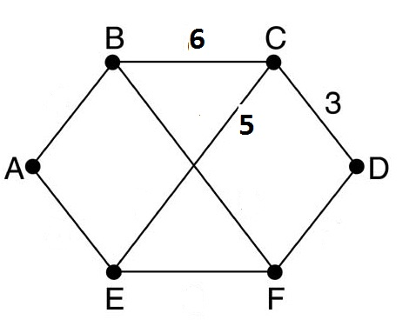
Consider the subnet of the following figure:
Distance vector routing is used, and the following vectors have
just come into router C:
from B: (5, 0, 8, 12, 6, 2);
from D: (16, 12, 6, 0, 9, 10);
from E: (7, 6, 3, 9, 0, 4).
The measured delays to B, D and E, are 6, 3, and 5, respectively.
What is C's new routing table? Give both the outgoing line to use and the expected delay.

Slide 6
Answer:
Going via B: 6 + (5, 0, 8, 12, 6, 2)→ (11, 6, 14, 18, 12, 8)
Going via D: 3 + (16,12,6,0,9,10) →(19, 15, 9, 3, 12, 13).
Going via E: 5 + (7, 6, 3, 9, 0, 4) → (12, 11, 8, 14, 5, 9).
Taking the minimum (except C) gives: (11, 6, 0, 3, 5, 8)
The outgoing lines are: (B, B, –, D, E, B).

Slide 7
Is fragmentation needed in concatenated virtual circuit internets, or only in datagram systems?
It is needed in both. Even in a concatenated virtual-circuit network, some networks along the path might accept 1024-byte packets, and others might only accept 48-byte packets. Fragmentation is still needed.

Slide 8
Tunneling through a concatenated virtual circuit subnet is straightforward: the multiprotocol router at one end just set up a virtual circuit to the other end and passes packets through it. Can tunneling also be used in datagram subnet? If so, how?

Slide 9
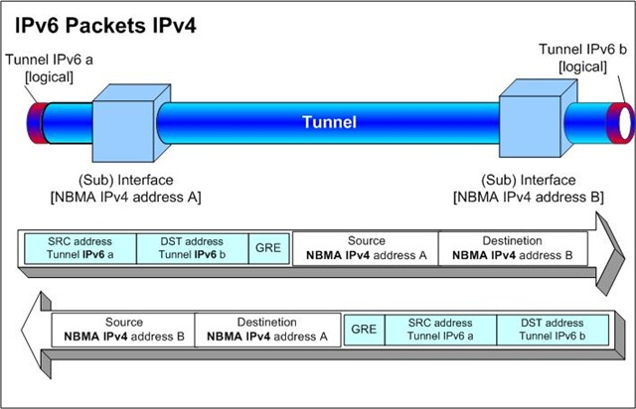
No problem. Just encapsulate the packet in the payload field of a datagram belonging to the subnet being passed through and send it.

Slide 10
IPv6 uses 16-byte addresses. If a block of 1 million address is allocated every picosecond (= 10⁻¹² sec), how long will the addresses last?
With 16 bytes there are 2¹²⁸ or 3.4 × 10³⁸ addresses. If we allocate them at a rate of 10¹⁸ per second, they will last for 10¹³ years. This number is 1000 times the age of the universe.
Of course, the address space is not flat, so they are not allocated linearly, but this calculation shows that even with an allocation scheme that has an efficiency of 1/1000 (0.1 percent), one will never run out.

